Slide 1

Making the most of
your membership

Slide 2
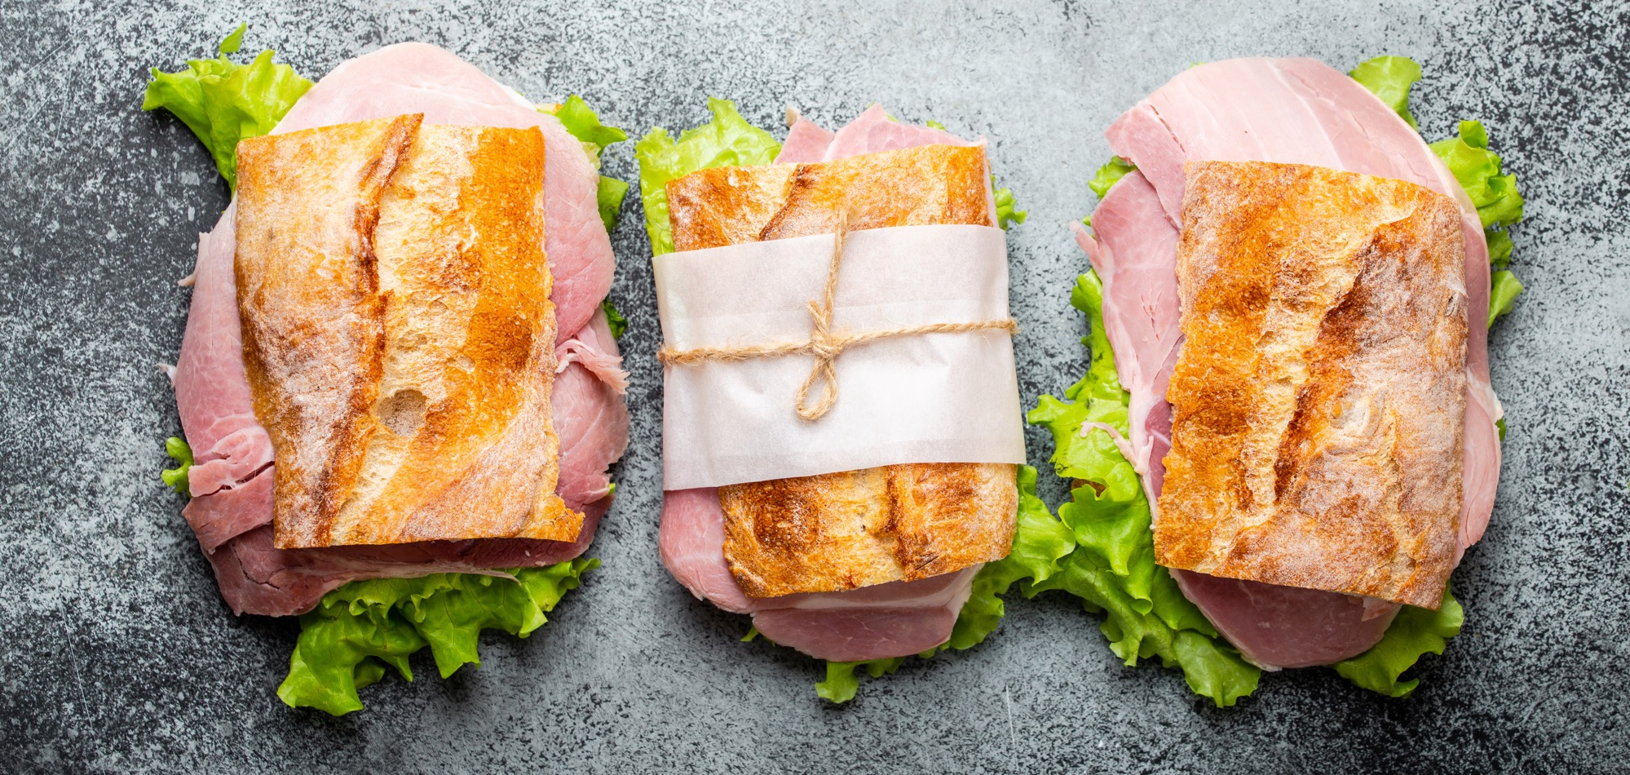

Who we are
We’re the voice of the sandwich and food-to-go industry in the UK, enabling our members to do business more effectively and helping them challenge legislation and other factors that could be damaging to their businesses.

Slide 3
What we do
We provide a platform for you to grow, bringing you together with like-minded industry professionals; representing your voice in Westminster; and providing extensive guidance around implementation
of legislation that’s relevant for your business.

Slide 4

Nine reasons to join
Co-marketing opportunities and savings on relevant services
Technical expertise - online resources and Assured advice
Make sure your voice is heard in government
Save money on The Sammies
Access our technical sessions that shape industry best practice
Opportunities for insights & networking
Subscriptions to the most relevant publications for the food-to-go sector
Stay informed and up to date around issues that impact how you do business
Boost your profile

Slide 5

Boost your profile with key industry decision makers
We help you boost your profile in three keyways:
Upon joining, we’ll profile your business in in our bi-monthly magazine, Sandwich and Food to Go News which reaches over 5,000 decision makers across our industry.
Your business will be listed in the dedicated supplier zone on our website, helping to connect you with those interested in sourcing your products. Over 8,000 people visit our website each month.
Your business will be listed in the product index of every issue of Sandwich and Food-to-go News for the duration of your membership.

Slide 6
Opportunities for insights and networking at member only briefing sessions
As a member we’ll provide you with opportunities to meet and network with potential customers at exclusive Association events, where you’ll have the chance to learn about latest industry trends and hear from industry leaders.
You’ll have the chance to join at least three of these exclusive sessions per year in London.

Slide 7
Make sure your voice is heard in government
As a Stakeholder, recognised by Government as representing the sandwich and food-to-go sector, we are there to represent the interests of our market, providing a voice both collectively and individually for all our members.

Slide 8
Stay informed and up to date around issues that impact how you do business
We know your business and the issues that matter to you, so we will let you know about important developments, whether around legislation or key market developments, that could directly affect your business.
We’ll also give you access to the full minutes from our Board meetings where we discuss issues and decide on policy so that you can keep up-to-date with what the Association is doing.
Plus, you’ll receive our quarterly updates, where we share all that’s happened in the past three months and flag up what to expect in the three months ahead.

Slide 9
Technical expertise – sessions to build and share knowledge
As a member your technical team will have full access to BSA guidance and advice.
They will also be able to attend specialist briefings and networking sessions – distinct from our broader membership sessions – at least twice a year and will be able to have input into developing guidance for the industry.

Slide 10
Technical expertise – advice and support
We will also help your technical team obtain the best advice when they need it.
All our members are covered by our Primary Authority Agreement, which means we can get advice on the interpretation of legislation from Government sources that is Assured and difficult for EHO’s to challenge.
Furthermore, members can use the Association’s agreement to clarify issues raised by EHO’s or to check things like the legality of wording on labels.
Members also have access to the Association’s Technical Manager and our helpline service which provides free telephone guidance on health & safety as well as employment matters.

Slide 11
Subscriptions to the most relevant industry publications for the sector
You will receive two key sector magazines, Sandwich and Food-to-go News, and Café Life, as part of your membership.
These bi-monthly publications will help to keep you up-to-date with the latest trends and developments in the industry, including what potential customers are doing in the market.
Your business and products/services will be listed in each edition, helping to raise your profile in your area of specialism.

Slide 12
Save money on the Sammies
Your businesses will also benefit from discounted rates at key Association events, including the popular Sammies awards, the annual celebration of all that’s best in our industry.
And don’t forget you can always enter the awards as well.

Slide 13
Co-marketing opportunities
From time-to-time there are opportunities for members to be involved in co-marketing opportunities such as around British Sandwich Week.
Each May the Association undertakes an intense media campaign to promote sandwiches and associated products, reaching over 30 million consumers. The Week also features on posters across the rail network.
Members can take advantage of this by linking their own marketing to the campaign. If you’re looking to cement your position at the heart of the industry, this is a great opportunity to do so.

Slide 14
Savings on relevant products and services….
Member businesses have access to preferential rates on a range of key services.
Plus we can introduce you to a variety of partners specialising in our sector, across aspects such as finance, PR and social media.

Slide 15
What it costs
Supplier membership costs £1,650 +VAT per year.
To join us simply email
paul@sandwich.org.uk or sandra@sandwich.org.uk

